Slide 1
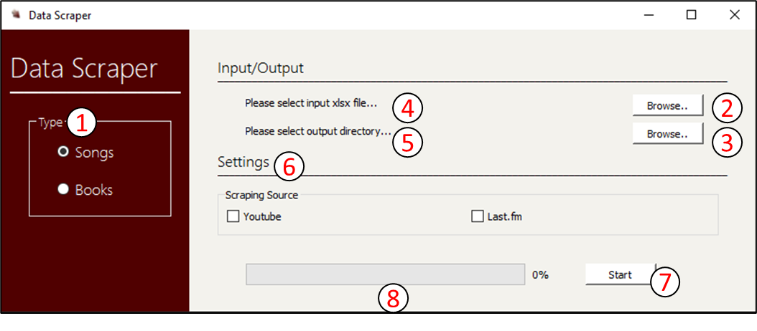
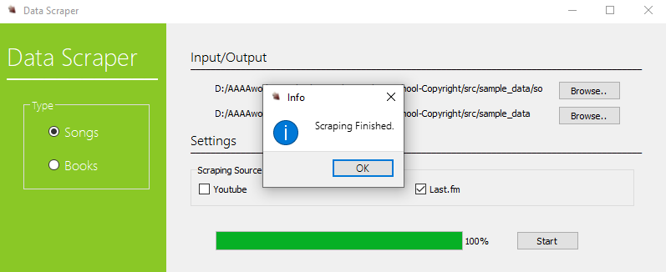
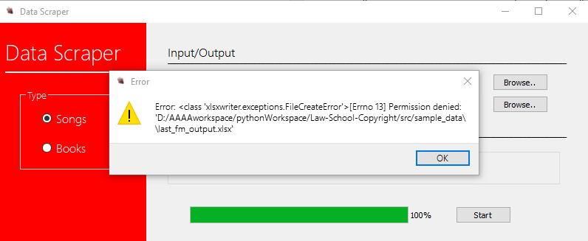

LAW SCHOOL COPYRIGHT PROJECT
Presenter: Aditya Atul Vijayvergia, Chen Liang, David Qin, Fengqiao Wang, Joseph Cineros, Sicong Huang, Paul Quek Client: Dr. Glynn Lunney
Introduction
System Structure
User Interface
Develop program for Dr. Glynn Lunney for copyright related price information scraping. The data will be used by client for copyright optimal duration and copyright protection evaluation research
Automatic scraping program for copyright related price information collection
Diverse scraping source - Support multiple scraping source (Amazon, Last.fm, YouTube) and multiple types of data (songs, books)
Efficiency - Support parallel scraping and multi-threading scraping
User friendly - All functions are integrated into one user interface to serve as a one-stop solution for data scraping
Support multiple types of spreadsheet as input
Support multi-sheet processing
Input
Multi-sheet spreadsheet file
One-stop user interface for all scraping functions
Parallel processing for scraping programs
Minimum text description
Background color changes when program status changes
GUI and Main
Process Manager
YouTube API
Amazon API
Last.fm API
Output:
Songs Scraper
User Interface
Youtube Data API
Public API that allows the user to gather youtube related data. In our case, we look for common video statistics such as likes, duration, and views for various popular songs.
Powerful and cheap requests that provide json readable data
Search queries can gather multiple videos at once and can process many searches in succession
Main
Books Scraper
Amazon Books Scrapper
Extracts book prices from amazon.com for all types of book versions available (ebook, audio, kindle, hardcover, paperback, etc)
Self made scrapper, hence free of cost, requires no credentials.
No restrictions on number of books searched
Success
Last.FM API
Free, allows mass data queries
REST request
JSON response
Extensive availability
Error
REFERENCES:
https://github.com/Innoversa/Law-School-Copyright

